Slide 1
Project 1
Tawadrous Heshmat
ID =6582-3593-3961

Slide 2
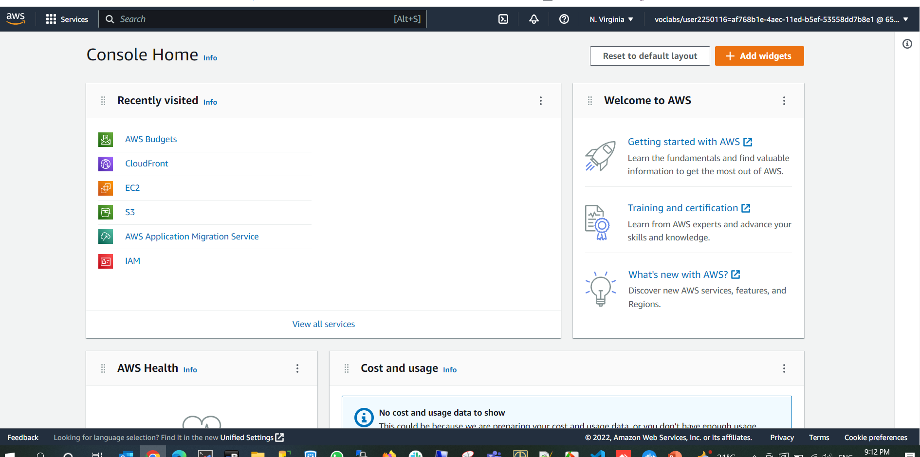
Console Home

Slide 3
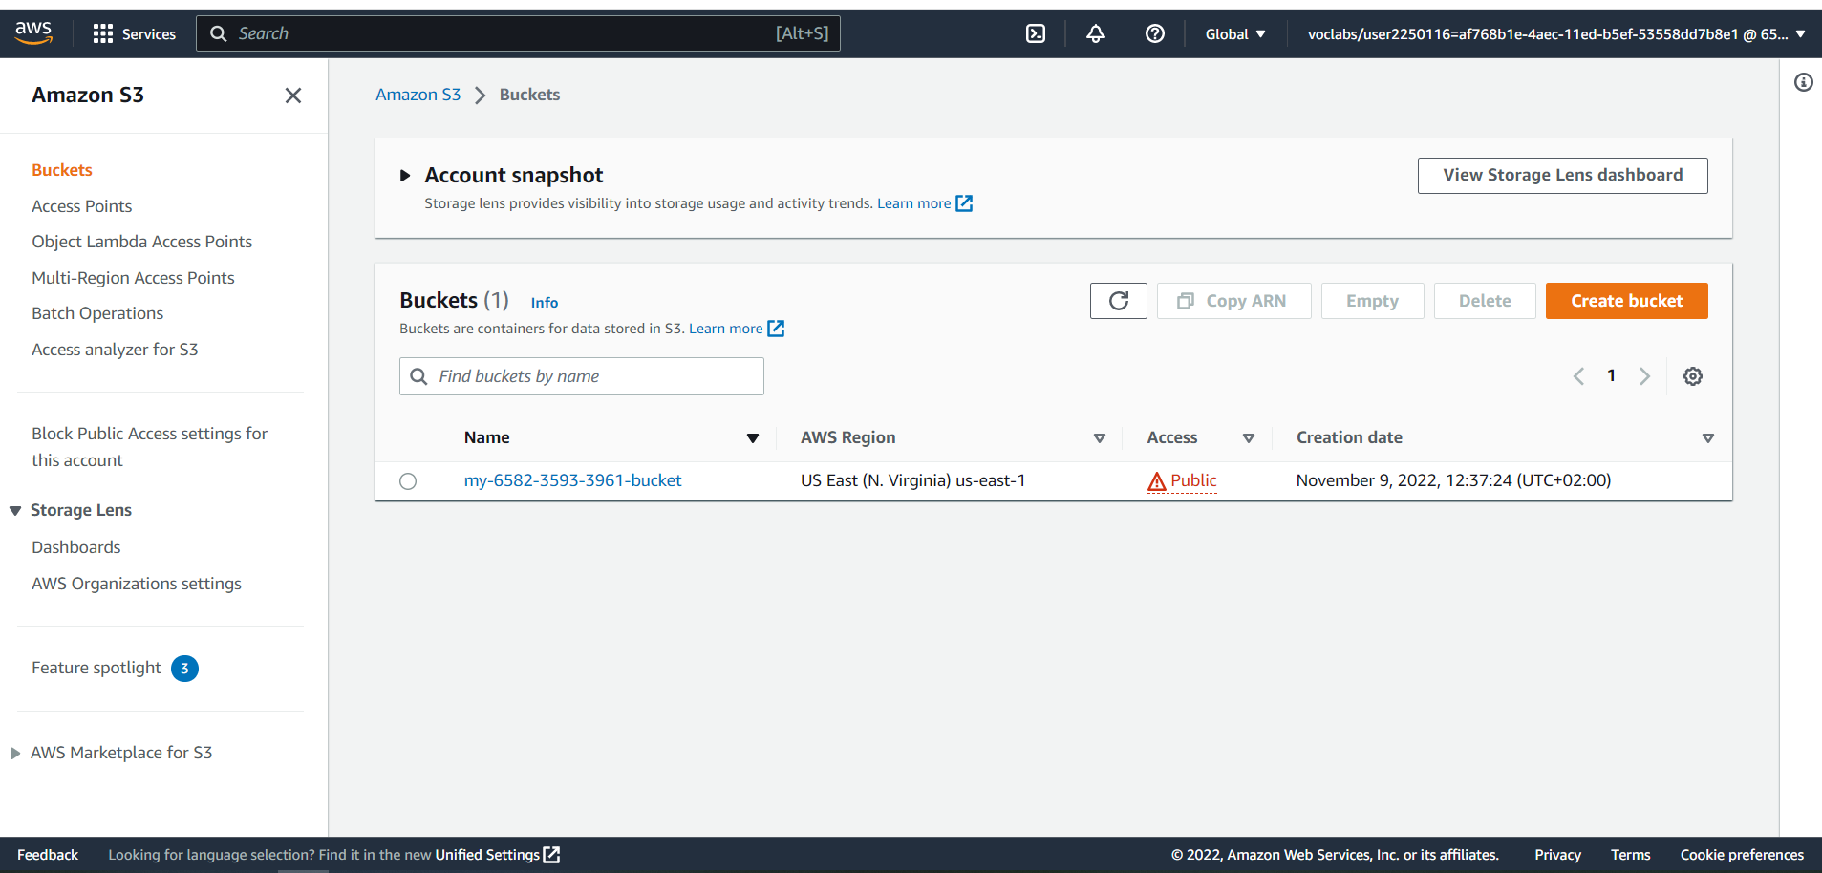
S3 Bucket

Slide 4
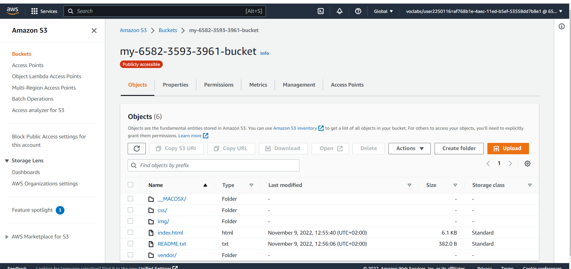
Uploaded Files

Slide 5
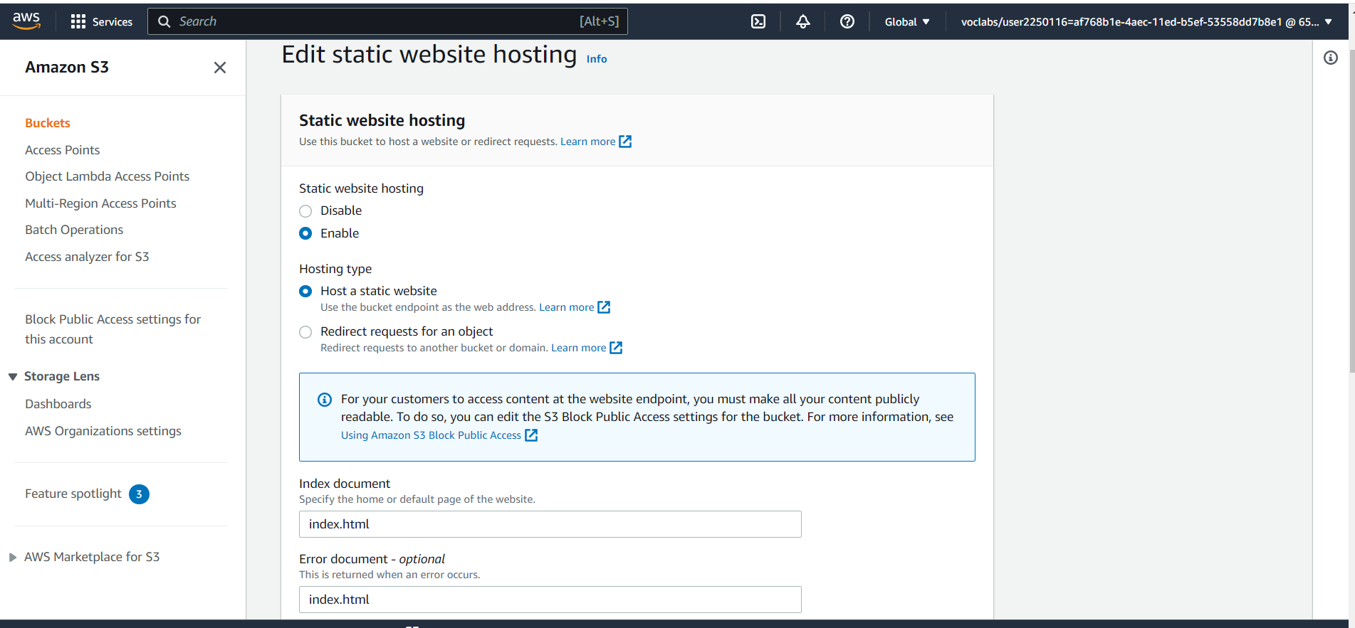
Static Website Hosting

Slide 6
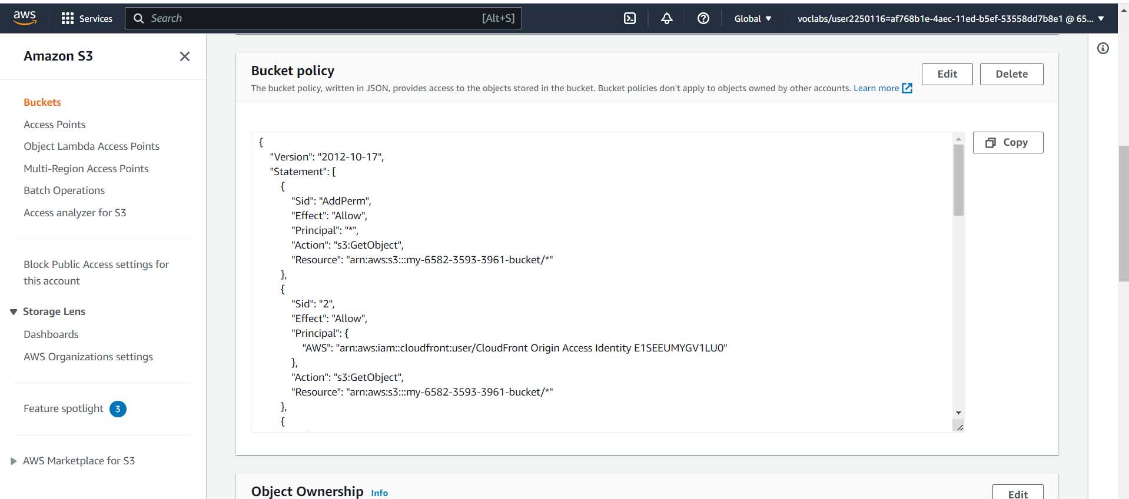
Bucket Policy

Slide 7
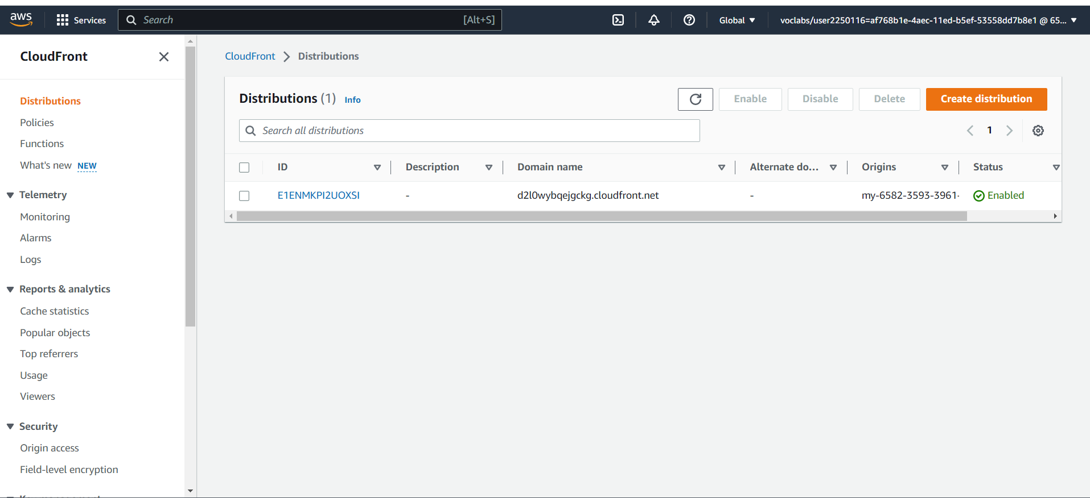
CloudFront Distributions

Slide 8

https://d2l0wybqejgckg.cloudfront.net

Slide 9

http://my-6582-3593-3961-bucket.s3-website-us-east-1.amazonaws.com

Slide 10

https://my-6582-3593-3961-bucket.s3.amazonaws.com/index.html

